Slide 1
Book Exchange
Swap, Connect And Change The World
An Open Innovation Project
By Team Z

Slide 2
About Us
We are BookExchange. We provide an online networking platform for nerds to connect with each other having similar interests . Through BookExchange, we provide easy and affordable access to costly and somewhat rare novels out there by building a community of bibliophiles.
Online Book Exchange Project
Easy And Affordable Book Rentals
Search, Manage And Issue Book
Explore New Books And Novel
Rent/Buy At Affordable Price

Slide 3
PROBLEMs
MARKET GAP
The Market Of Hard Book Literature , Even Though Threatened By A Market Occupied By Online Readers , Find It Very Difficult To Find It’s Customers.
CUSTOMERS
Even Though With The Disturbance By The Online Readers , There Is A Huge Market Of Offline Readers , That Needed To Be Found.
FINANCIALS
Offline Books Sale Is Upto 4.81 Billion USD And Is Still Growing.

Slide 4
SOLUTION
CLOSE THE GAP
Our Product Offers An Easy Access To Different Novels That Can Be Easily Delivered To Your Location.
TARGET AUDIENCE
Anyone Who Reads
COST SAVINGS
We Provide An Affordable Price For Renting The Books.
EASY TO USE
The Website Design Is Simple And Easy To Use.

Slide 5
To Whom We Compete
In A Competitive World, We Are Trying To Develop A Platform That Are Easy Accessible, User Friendly And Is Strictly Based On The Need Of Our Users.
Our Probable Competent Are
Kindle
AudioBook
Audible

Slide 6



Unique Features
Get Recommendations Through Our ChatBox
Swap Among The Users
Reduce, Reuse And Recycle

Slide 7



BUSINESS MODEL
RESEARCH
CUSTOMERS
ABSTRACT
We based our research on market trends and commercial sales
We believe people who reads need to get a platform where they can buy, share and rent books
Our buissness model’s design is user friendly and promotes reading.

Slide 8
MARKET Evaluation
$4.81B
$5.72B
March 2023
Growth As Per 2027

Slide 9
Tech - Stack
FrontEnd
DBMS
BackEnd
HTML , CSS , JAVASCRIPT,
BOOTSTRAP
SQL , FIREBASE AND CLOUD FIRE STORAGE
VUE-JS

Slide 10

REVENUE MODEL
AD Based Revenue
Rental Revenue
Author Publish Revenue

Slide 11
MARKETING STRATEGY
Advertisements through social networking platforms
Promotion through Bookfairs and collaboration with Cafes
Collaboration with ongoing startups and upcoming authors publishments

Slide 12
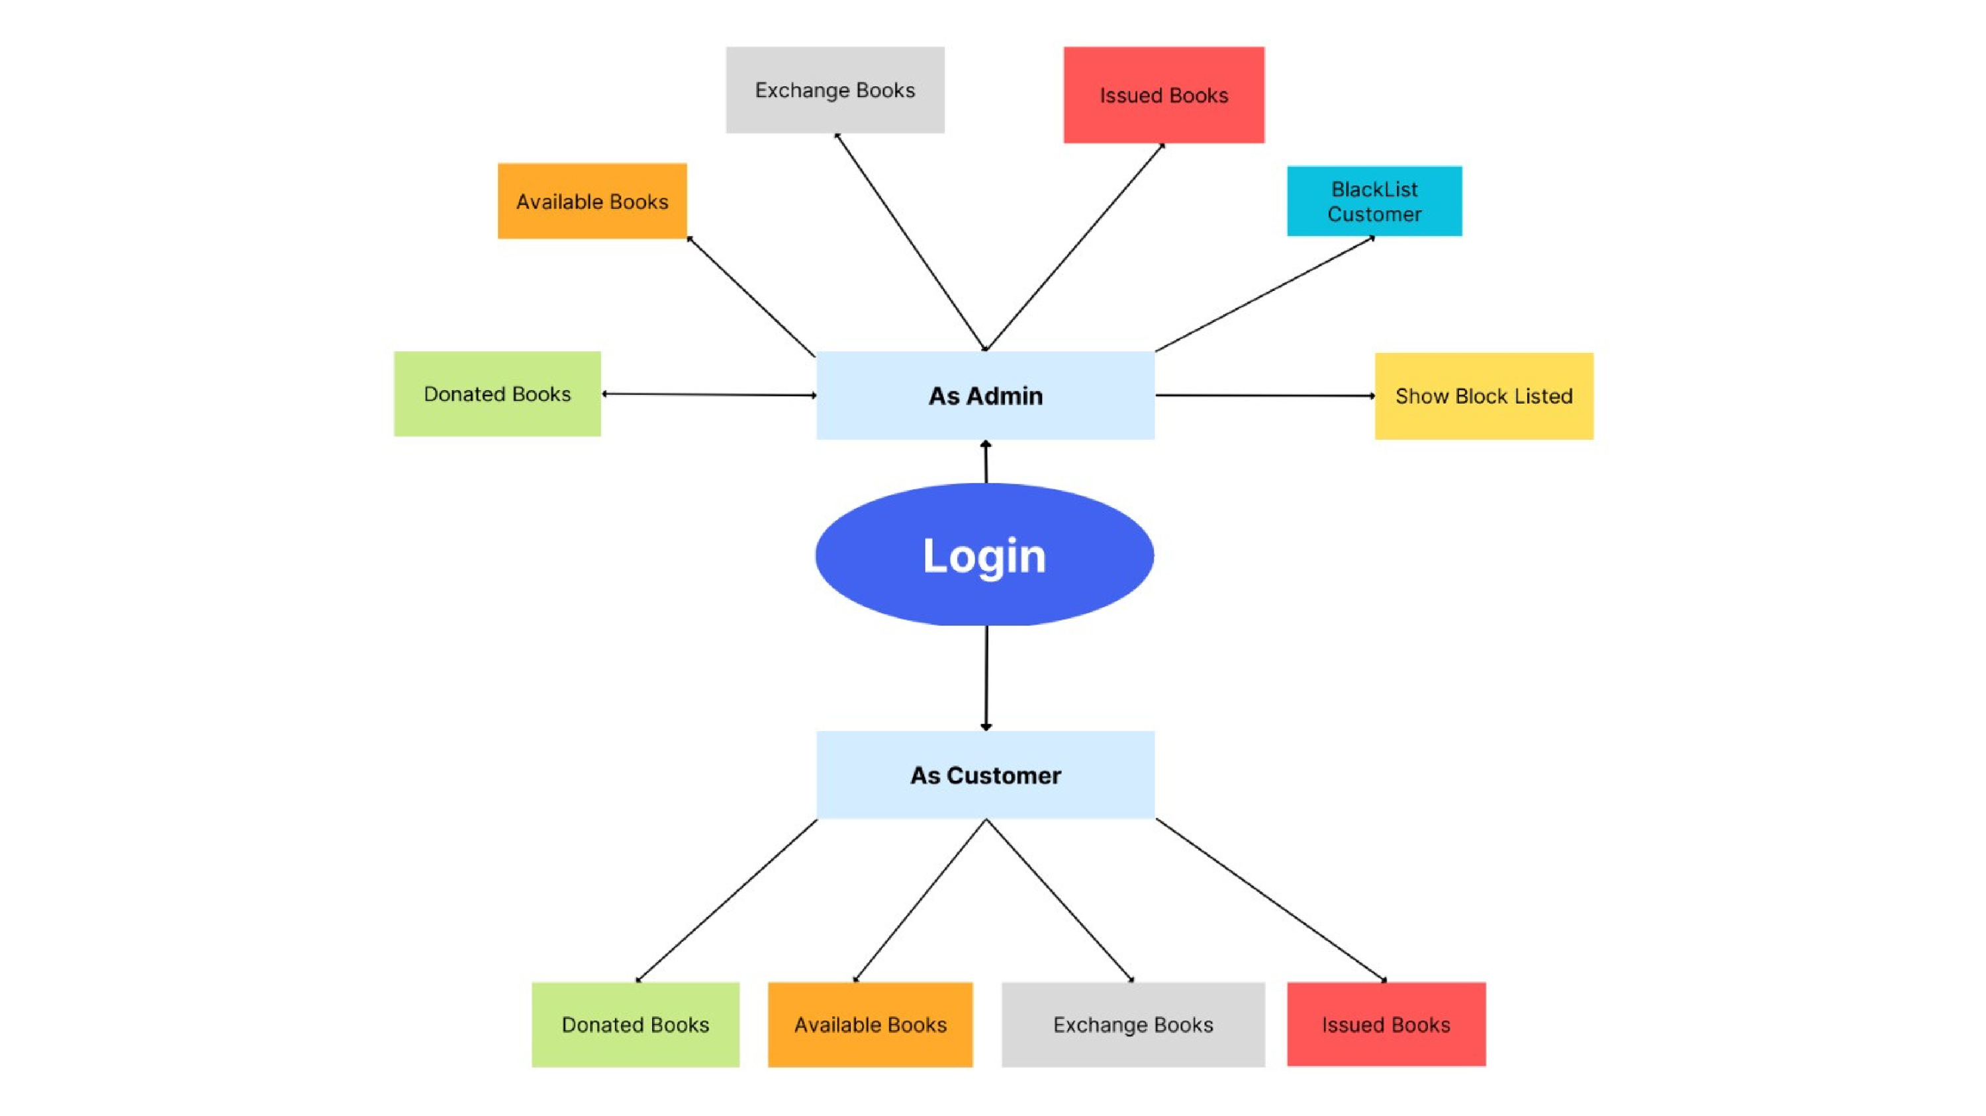

Slide 13




MEET THE TEAM
Aryan Agrawal
Anushk Jain
Harshit Goyal
Sparsh Shrivastava
Lead
Front End
Front End
Back End

Slide 14
THANK YOU
FROM TEAM Z

